Slide 1
Module 5

Slide 2
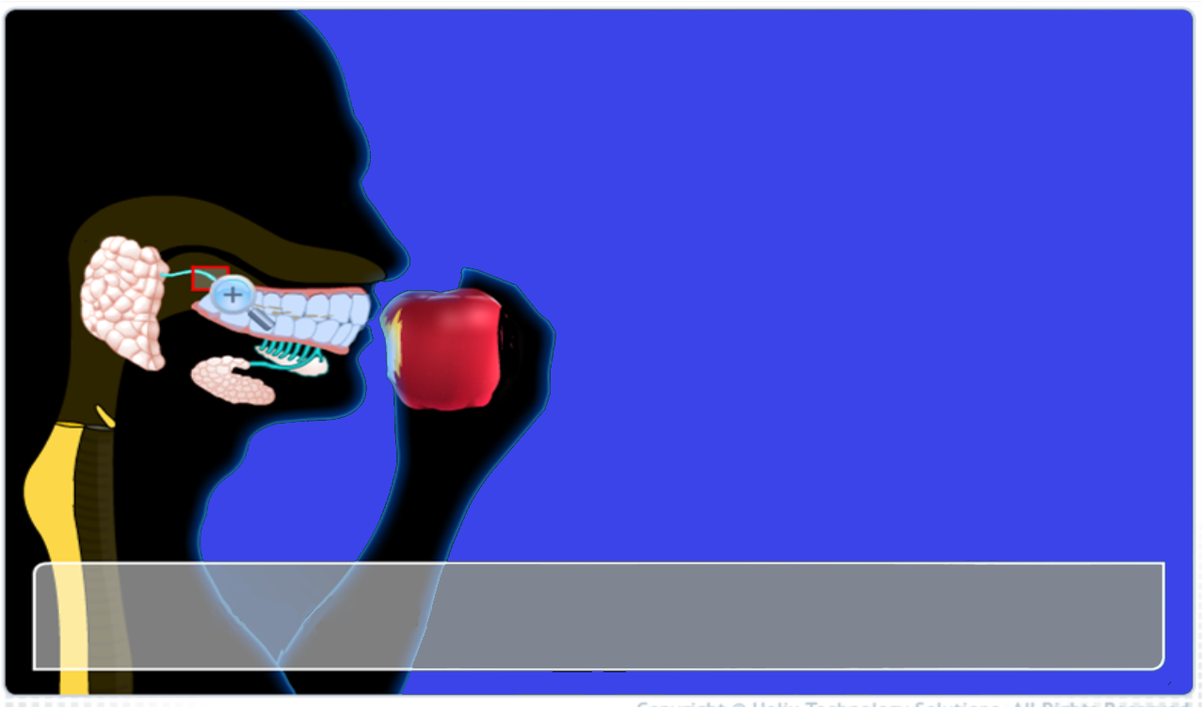
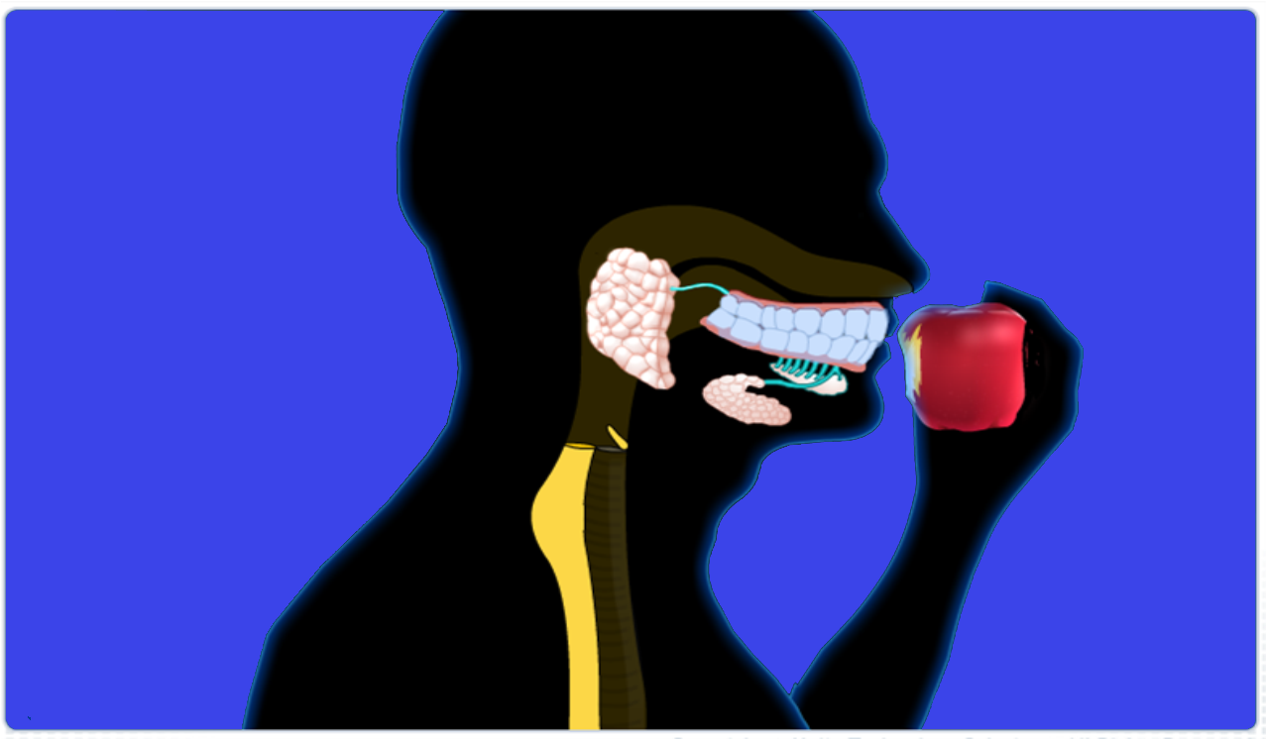
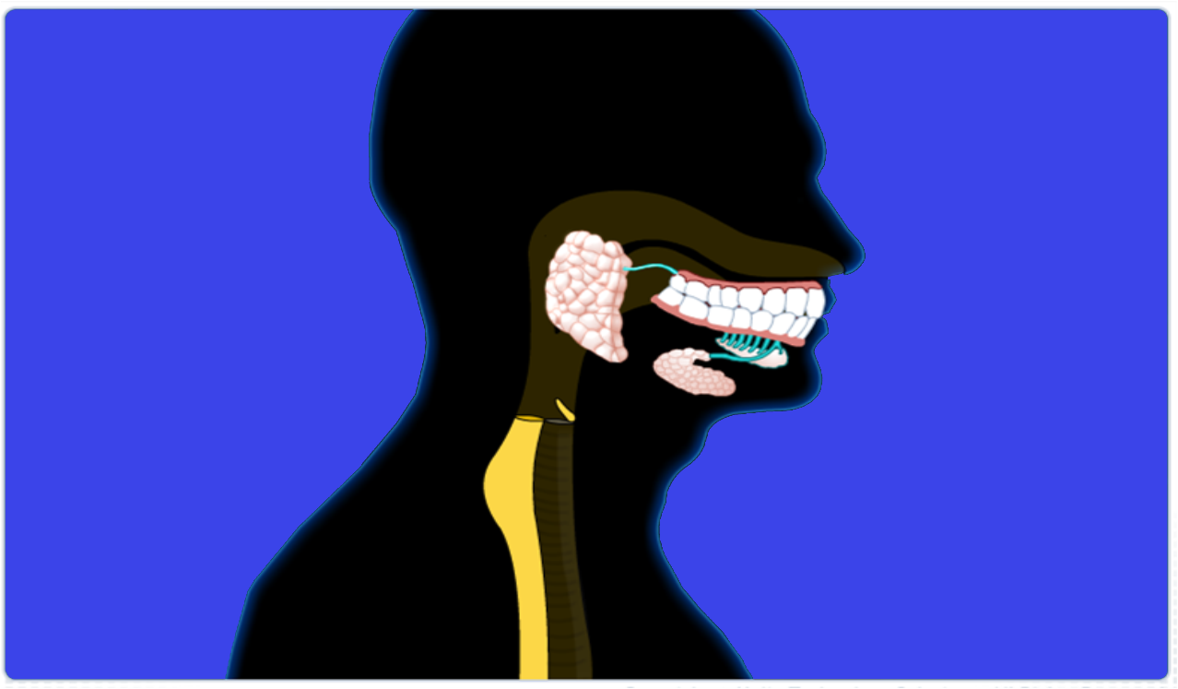

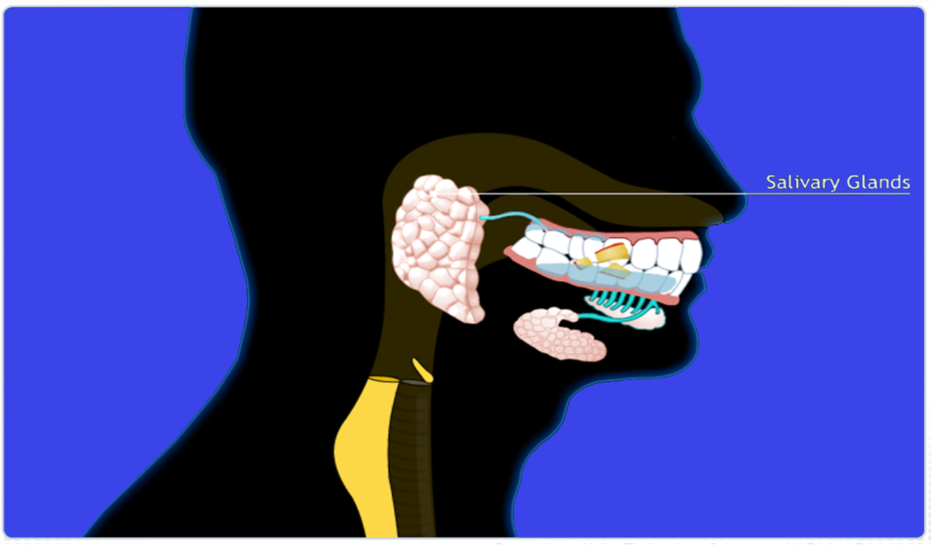
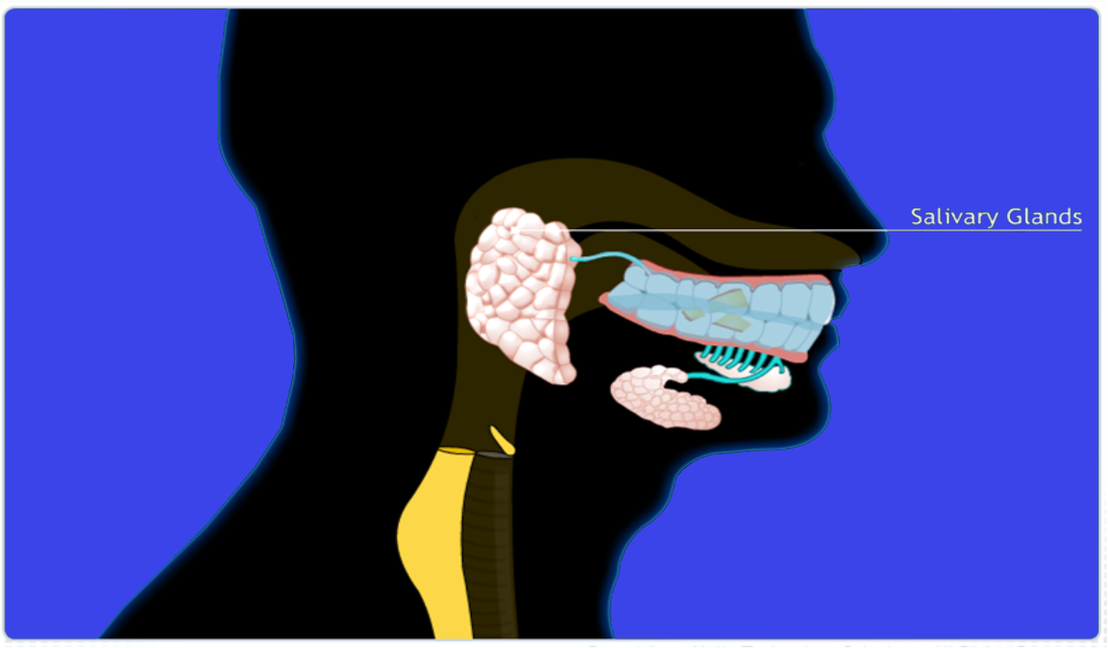
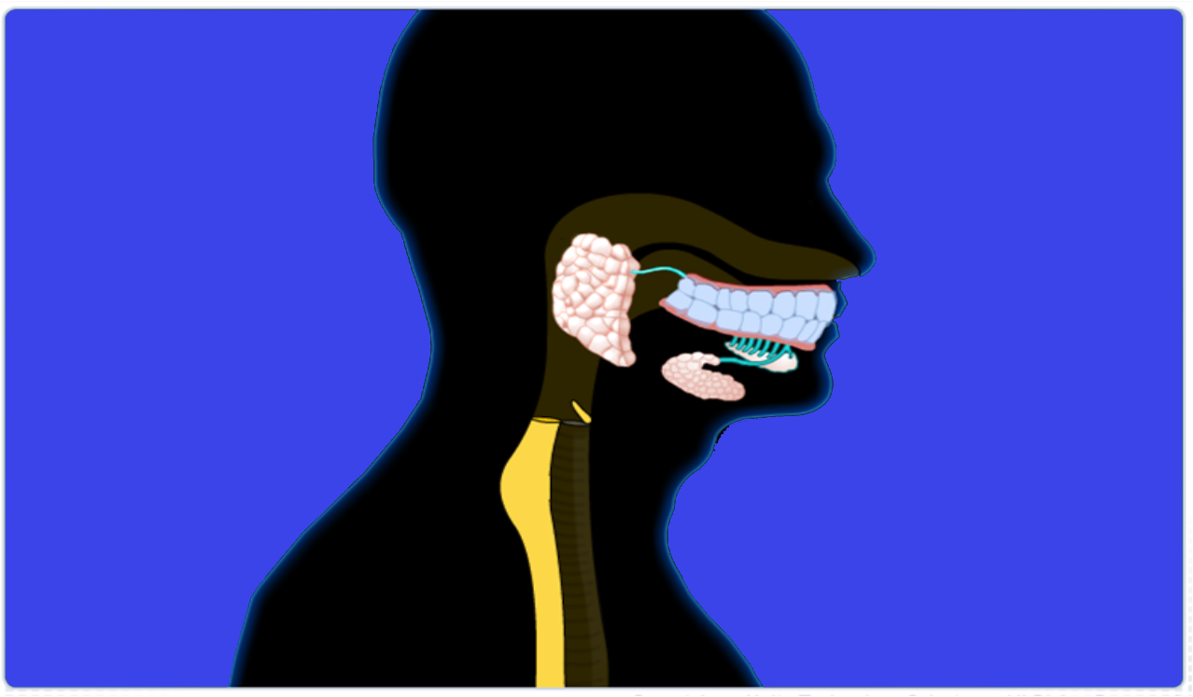


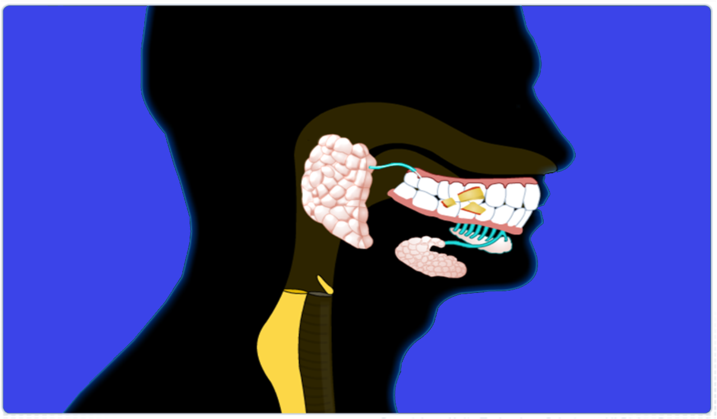

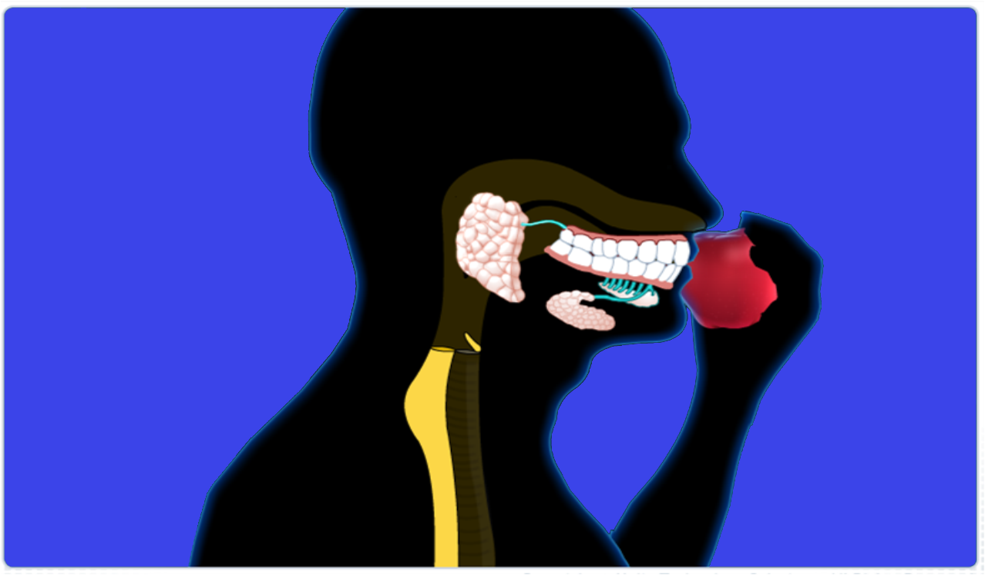
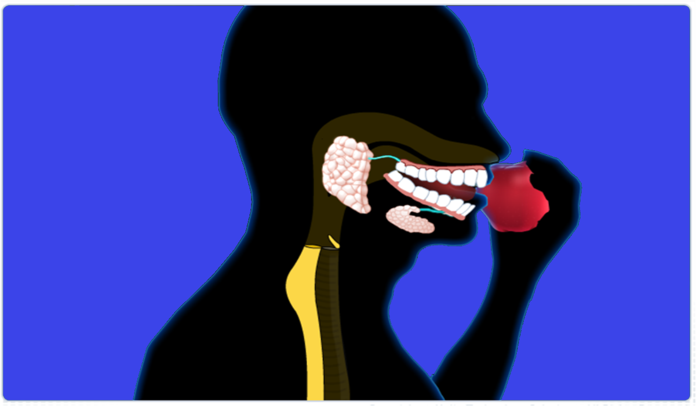
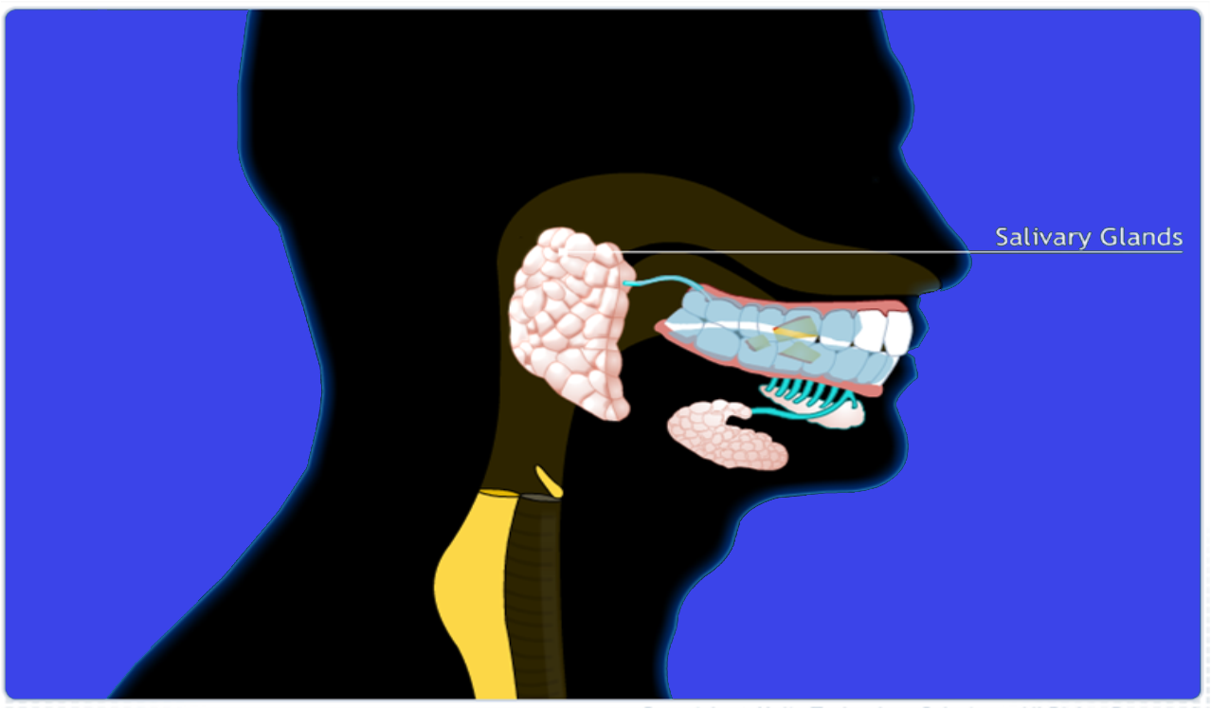
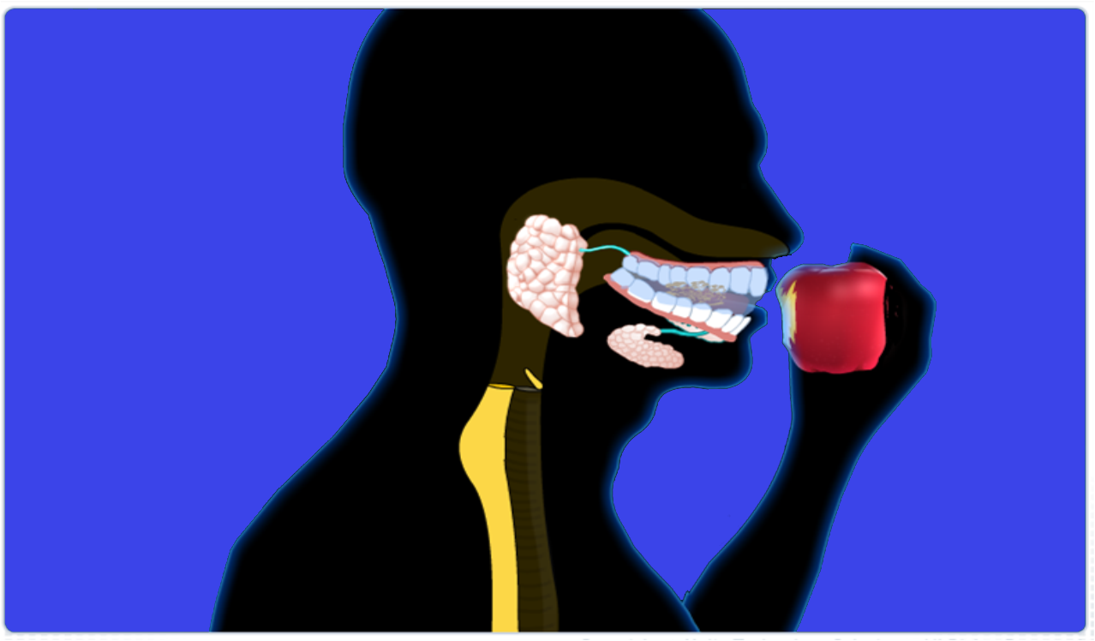
Saliva contains an enzyme called
The crushed food is wetted with Saliva secreted by the salivary glands
Inside the mouth the food is processed to generate particles with small size
So that it can pass through the soft lining of the alimentary canal
Chewed
Salivary amylase
Breaks it into
Starch
Sugar
Acts on
The food is taken in through the mouth
Starch (Complex sugar)
Salivary
Simple sugar
Food is partly digested in the mouth.
The digestion of food starts in the mouth
Amylase

Slide 3
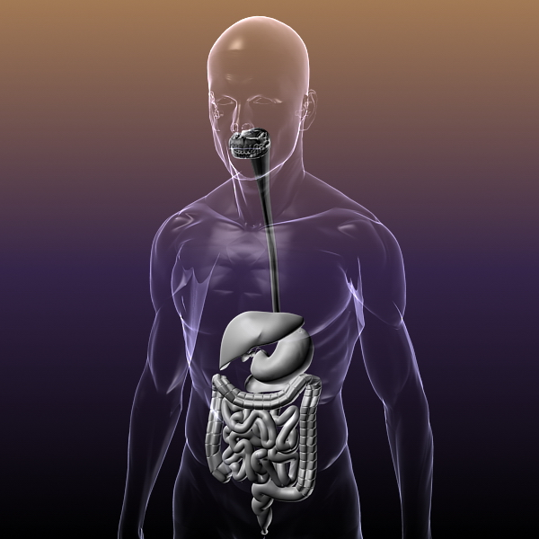
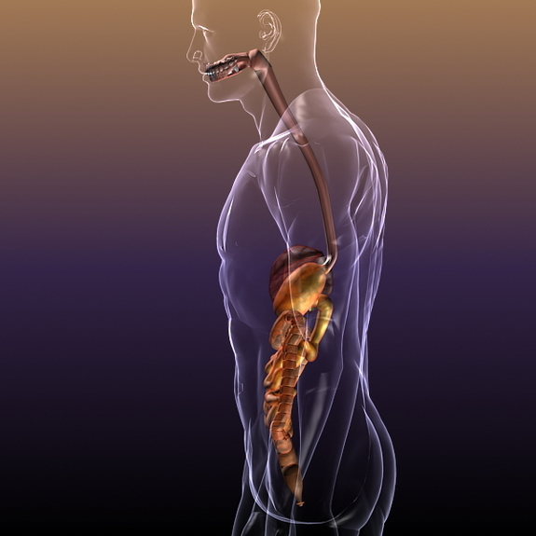
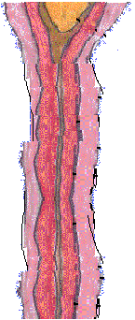
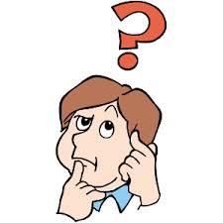
Due to the rhythmic contraction and relaxation of the muscles of oesophagus
How does this happen
Now the partly digested food goes down through the oesophagus
This is called as
peristaltic movement

Slide 4
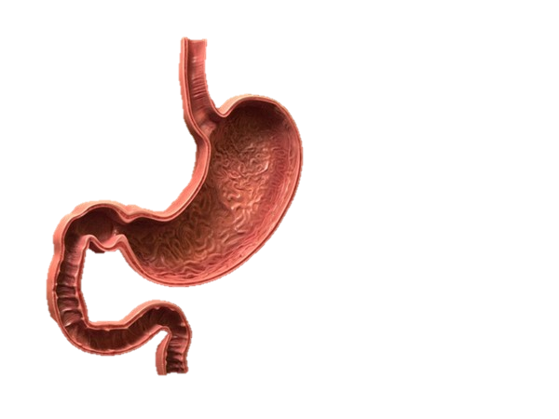
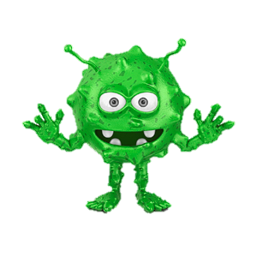
Now the food enters into a J shaped stomach
HCl kills the germs present in the food.
It also creates acidic conditions which are necessary for the digestion of proteins.
Now the Gastric glands present in the stomach release 3 gastric juices
What is the function of HCl ?
Gastric glands
Pepsin
Protein
First one is HCl
Gastric juices
Third juice is mucus which protects the inner lining of stomach from action of acid
Second juice is enzyme pepsin which digests proteins partially.

Slide 5
The partially digested food leaves the stomach
Sphincter muscle
The exit of the food from the stomach is regulated by a muscle called
Sphincter muscle

Slide 6
Thank You

